Slide 1
Introduction to Signals

Slide 2
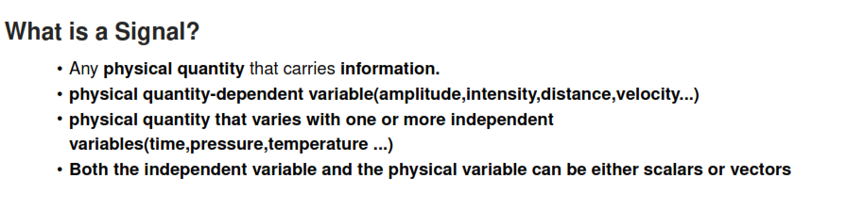
The dependent variable is the one being tested. It is called dependent because it depends on the independent variable. It is also called the responding variable.
The independent variable is the one which change or is controlled in an experiment. This is also called a manipulated variable.

Slide 3
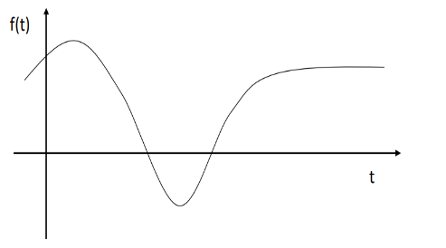
Types of Signals
Signals are defined as a function of one or more independent variables.
Depending on the number of independent variables signals are classified as:
1-dimensional signal: function of a single variable.
Multidimensional Signal: function of more than one variable
Examples for one dimensional Signal
Sound wave: Amplitude vs time

Slide 4
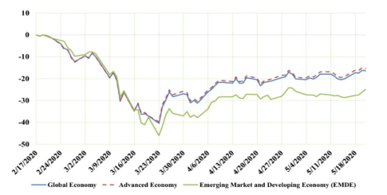
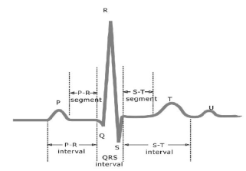
Stock prices fluctuate over time
ECG measures electrical activity of heart over time time

Slide 5
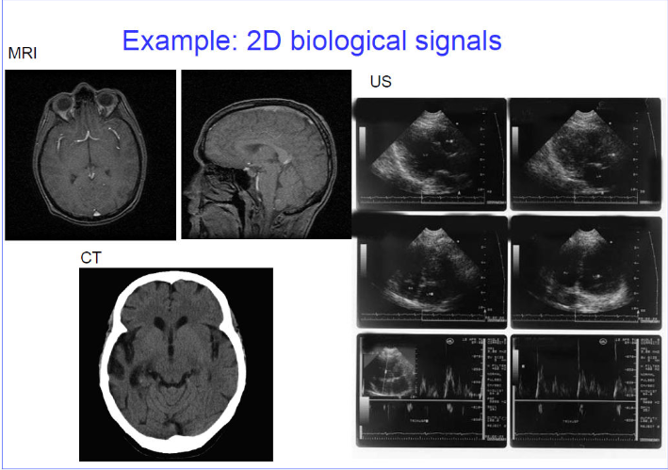

Examples for Multidimensional dimensional Signal- Image signal represented by f(x,y)
The brightness or color intensity of each pixel in an image changes based on its x and y position within the image.

Slide 6
Signal Processing
Signal Processing is the art of extracting insights and valuable information from signals, which are functions that convey data.
These signals can take forms such as:
Audio Signals (Sound waves), Image Signals (pixels), Video signals (frames), Biological signals (ECG, EEG etc.), sensor Signals (temperature, pressure etc.)
Signal Processing involves various techniques to:
Clean up signals by removing noise, transform signals to reveal hidden patterns or frequencies, analyse to extract features or characteristics, enhance signals to improve quality or clarity, compress signals to reduce storage or transmission requirements

Slide 7
Signal Processing has numerous applications in:
Audio Processing (music speech recognition)
Image processing (computer vision, object detection)
Video processing (video compression, object tracking)
Biomedical signal processing (medical diagnosis, monitoring)
Telecommunications (Signal transmission, reception)
Control Systems (Signal Control, automation)

Slide 8
Classification of Signals
Continuous Time and Discrete Time Signals
Deterministic and Random Signals
Even and Odd Signals
Continuous and Discrete Time Signals
Continuous time signals are continuous in time and amplitude. It is defined for all time t. Generally denoted by x(t).
Discrete time signals are discrete in time. Discrete time signals are defined for only integer values of time-represented as x(n).

Slide 9
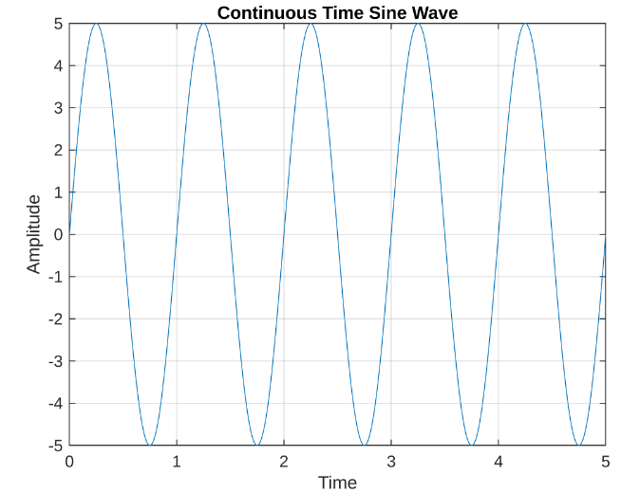
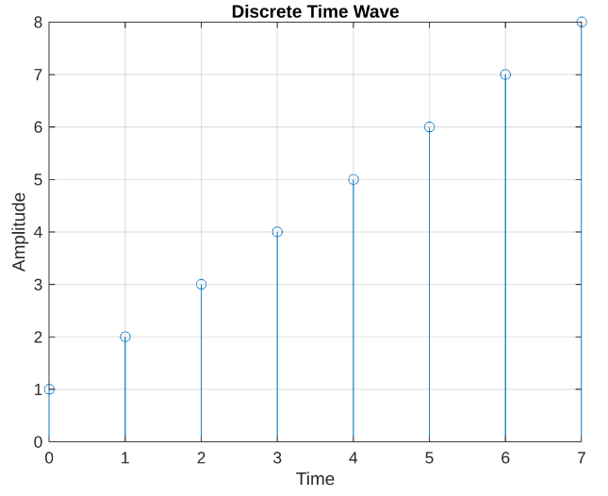

Slide 10
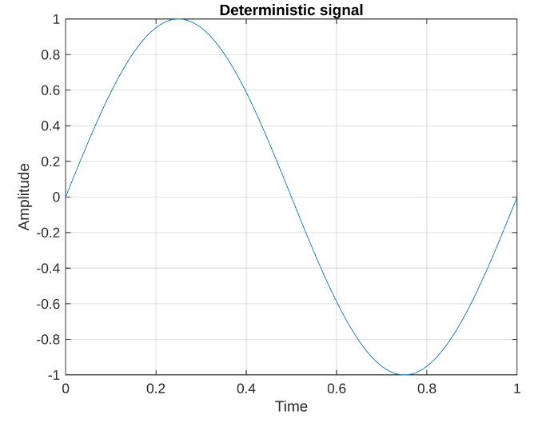
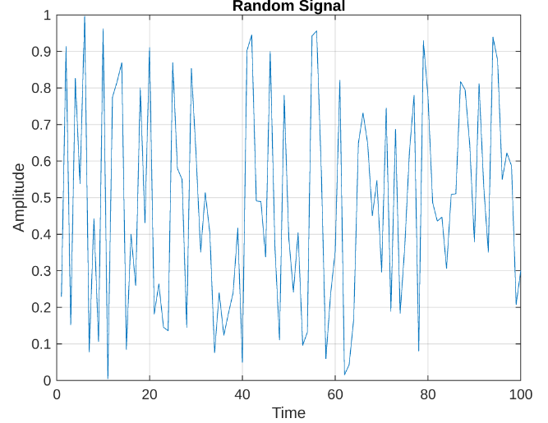
Deterministic and Random Signals
Deterministic signals can be represented by a mathematical formula. We can predict the result or the graphical representation with the help of that formula.
Random signals are characterized by uncertainty about its occurrence and is called a random signal. The results are not predictable. A random signal cannot be represented by any mathematical equation.
Eg: Thermal noise generated in an electric circuit.

Slide 11
Even and Odd Signals
The odd signals are signals that is unsymmetrical at the time origin or the vertical axis.
Eg: If
The even signals are signals that is symmetrical at the time origin or the vertical axis.
Eg: If

Slide 12
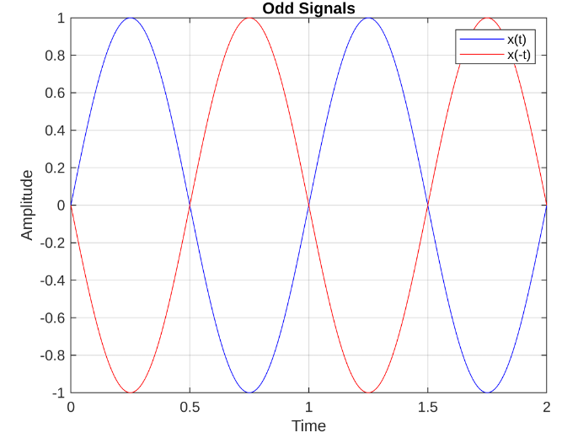
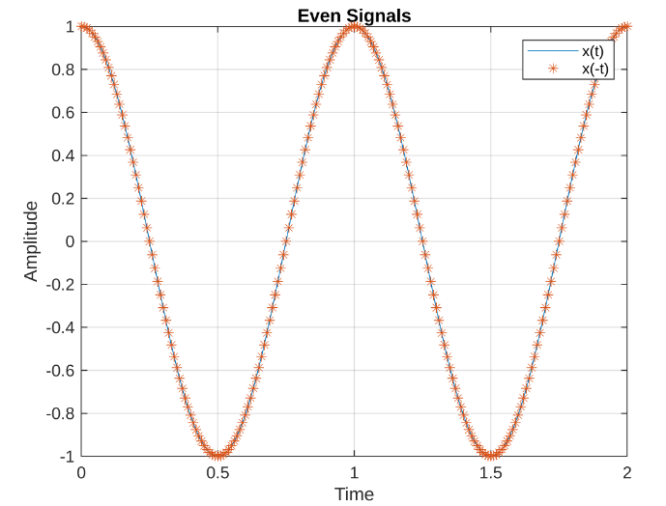
Odd and Even Signals

Slide 13
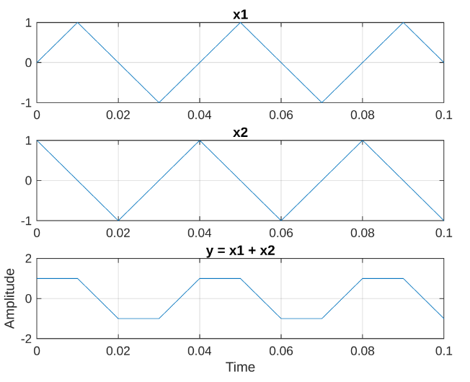
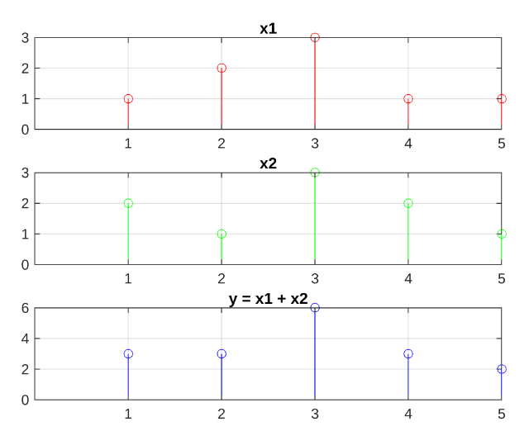
Basic Operations in Signals
1.Signal Addition
The addition of the signal is the process in which the amplitude of two signals is added and as a result, the signal obtained has the combination amplitude of both of these.

Slide 14
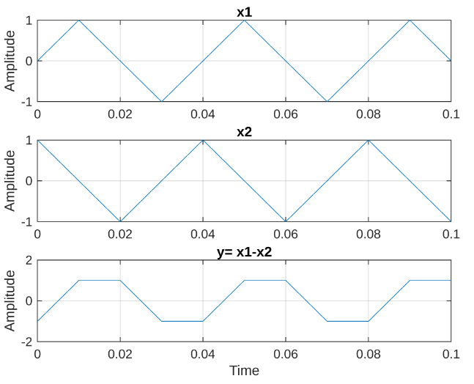
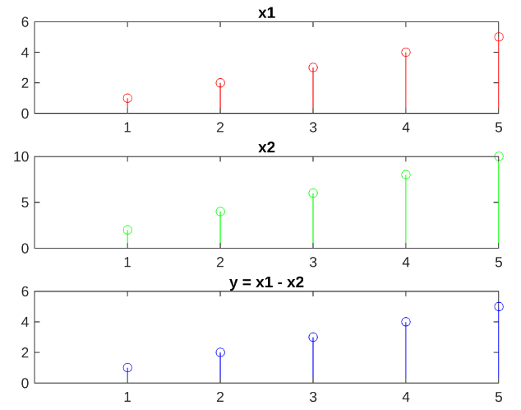
2. Signal Subtraction
The subtraction between the two signals takes place when the value of the second signal is subtracted from the first signal.

Slide 15
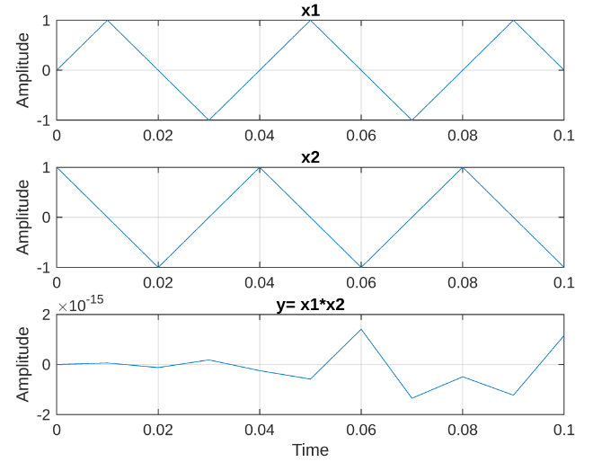
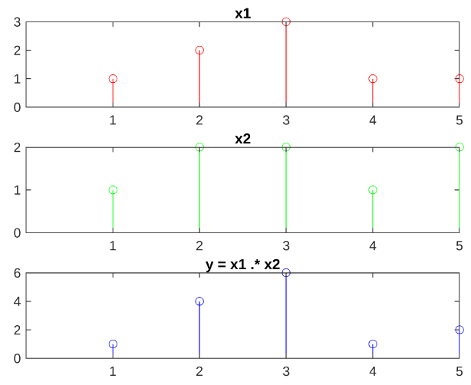
3. Signal Multiplication
The multiplication of two signals is obtained when the values of the amplitude of two signals are multiplied and the resultant signal has the multiplied amplitude.

Slide 16
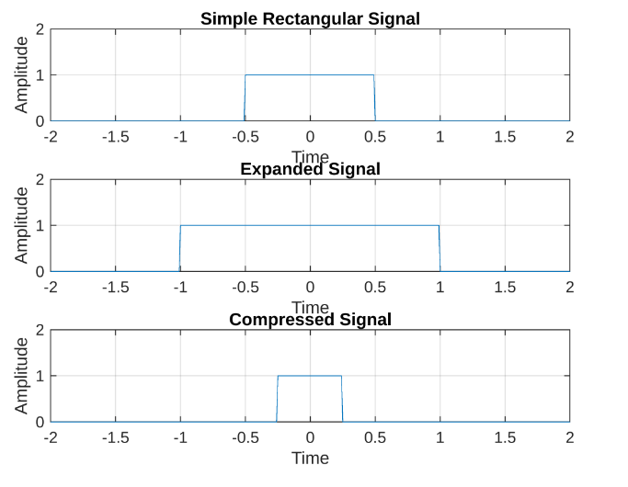
4. Time Scaling
Depending on the magnitude of the constant or scaling factor, the time scale of a signal has two responsibilities:
Compression , Expansion

Slide 17
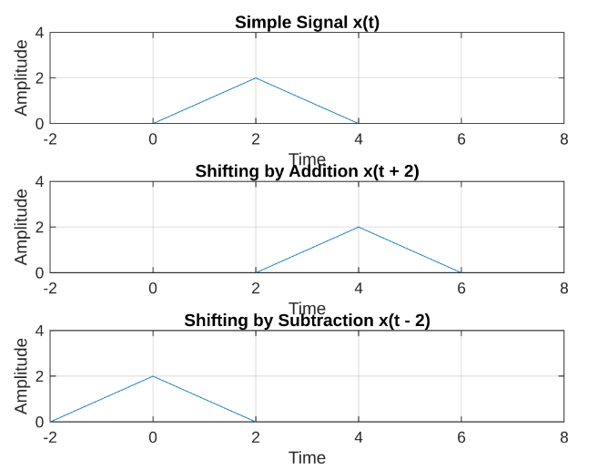
5. Time Shifting
The process of moving a signal forward or backward in time, the time shifting of a signal has two possibilities:
Addition in Time Shifting: The whole signal move towards the right side and the amplitude does not change
Subtraction in Time Shifting: Here the signal moves towards left side.

Slide 18
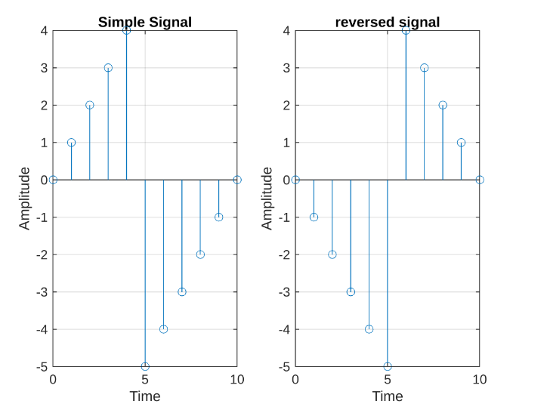
6. Time Reversal
The process of flipping the whole signal by using the flipping function or by multiplying the whole signal with a negative number is called reversal of the signal because each and every value of signals are reversed

